Slide 1
Make a Template For Your Template; Profit!
Rob Conery, Microsoft
@robconery
robcon@microsoft.com

Slide 2
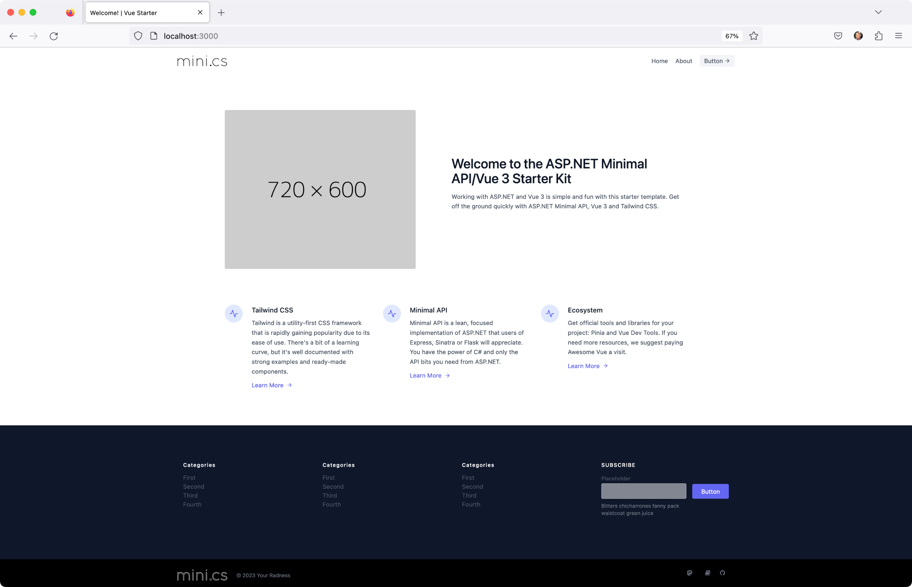

Slide 3
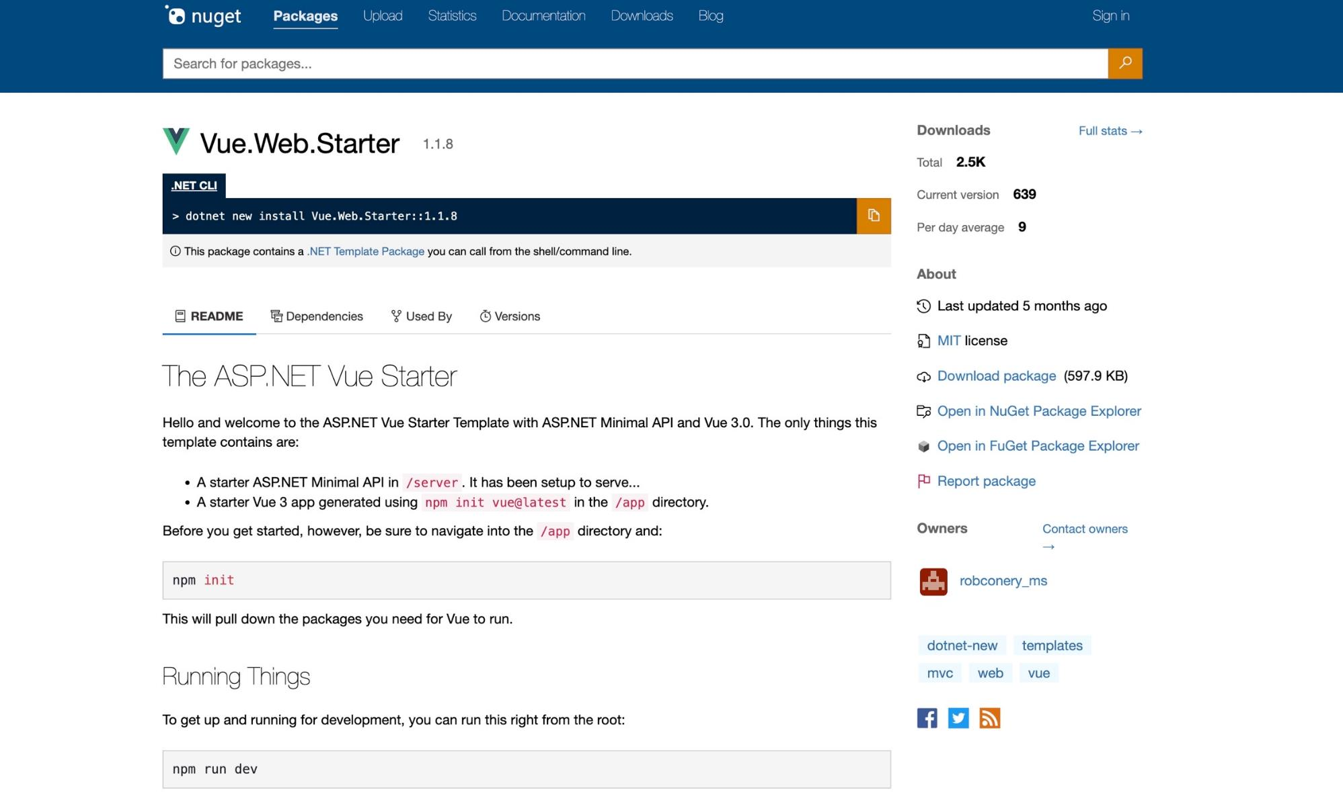

Slide 4
>
dotnet new install Vue.Web.Starter
The following template packages will be installed:
Vue.Web.Starter
Success: Vue.Web.Starter::1.1.8 installed the following templates:
Template Name Short Name Language Tags
------------------------------ ---------- -------- ---------------
ASP.NET Minimal API with Vue 3 vue Web Web Application
>
dotnet new vue -n myapp
The template "ASP.NET Minimal API with Vue 3" was created successfully.
>

